Slide 1
Presenter notes
Resources:
super-linter
Learning Lab: GitHub Actions and CI
Templates
Learning Lab: CD with Azure
Guide: GitHub Flow
Learning Lab: CD with AWS
Azure & Actions workflow samples
Roadmap: Manual approvals in workflows
https://azure.github.io/actions/
Demo prep:
No demos in this presentation
FAQ:
FAQ slides included per smaller topic
Customer stories:
N/A
Expected timing:

Slide 2
Actions: CI, CD, and releases
GitHub Bootcamp
@presenter name (optional)

Slide 3
This module will enable you to:
Define Continuous Integration (CI)
Define Continuous Development (CD)
Describe the CI/CD workflow with GitHub and Actions
Identify tools to build a CI/CD workflow

Slide 4
Agenda
CI/CD workflow with GitHub
Actions & CI
Actions, CD & release management

Slide 5
CI/CD workflow with GitHub

Slide 6
CI/CD workflow
Dev
Ops
Code/test
CI
Package
Deploy:
DEV/QA/IST
Deploy:
Preprod
Deploy:
Prod
Security testing
Security testing
CI
CD
Notes:
Some context on CI/CD
This the process of moving code from dev to prod to create working software. DevOps and CI/CD are often used interchangeably, although DevOps entails more than just CI/CD because it refers to the entire set of common best practices within software development. CI/CD and automation can be seen as a constituent of DevOps.
Continuous integration (CI) is a process that implements testing on every change, enabling users to see if their changes break anything in the environment.
Continuous delivery (CD) is the practice of building software in a way that allows you to deploy any successful release candidate to production at any time.
Continuous deployment (CD) takes continuous delivery a step further. With continuous deployment, every successful change is automatically deployed to production.
When a new feature or bugfix is developed it passes through several stages like unit tests, code quality, CI tests, deploying to various env.
In DevOps, this process is automated to a high degree or at least with minimum human intervention (e.g. deploying to production is often semi-automated where manual triaging & approval is required).
DevSecOps; shifting security left
Will be addressed in the Security session
Failing early and often
Examples from GitHub
~150 deploys/week, containing ~400 PRs/changes in total
High degree of automated testing
Thousands of tests run for a deploy

Slide 7
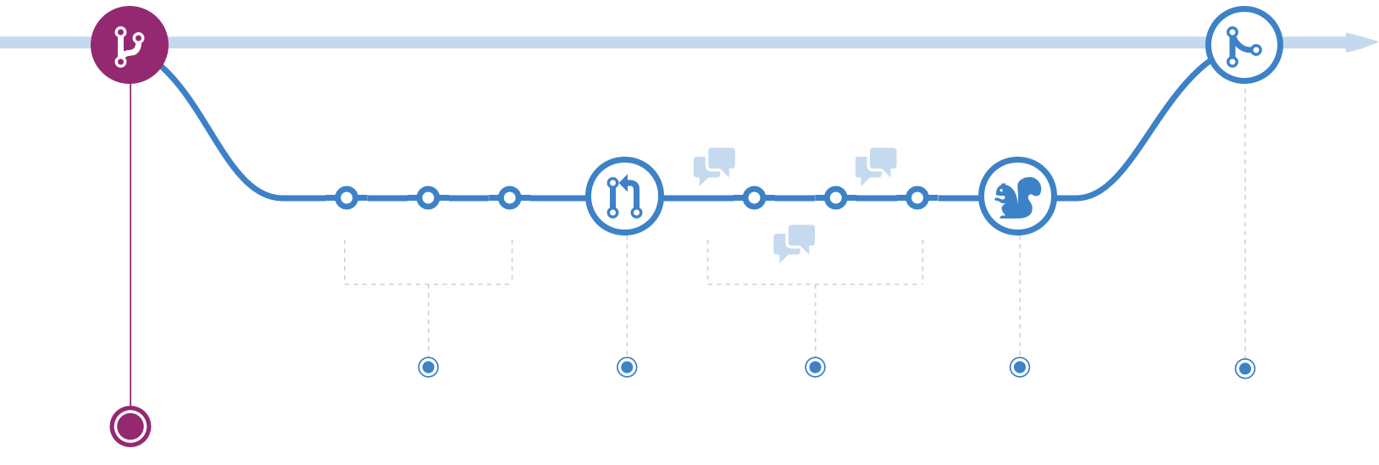
Create a Feature Branch
Notes:
Let's discuss how to this all works within the development flow in GitHub.
Working with Git and GitHub starts with a branch – we already discussed the importance of branch protection, and how it makes it safe for people to create branches for testing, experiments, or any new development.
*******
Resources
https://guides.github.com/introduction/flow/
********

Slide 8
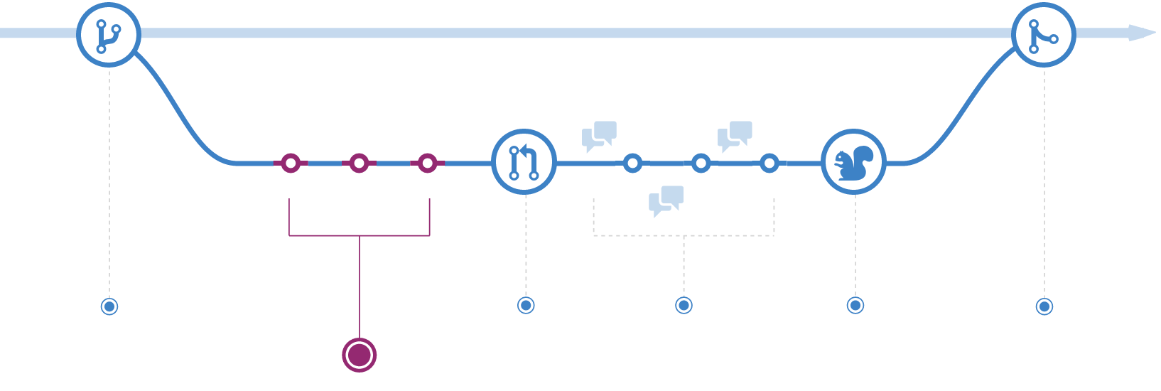
Add commits
Notes:
Then, people make commits on their branch, whether that's locally or pushed up to the remote on GitHub.

Slide 9
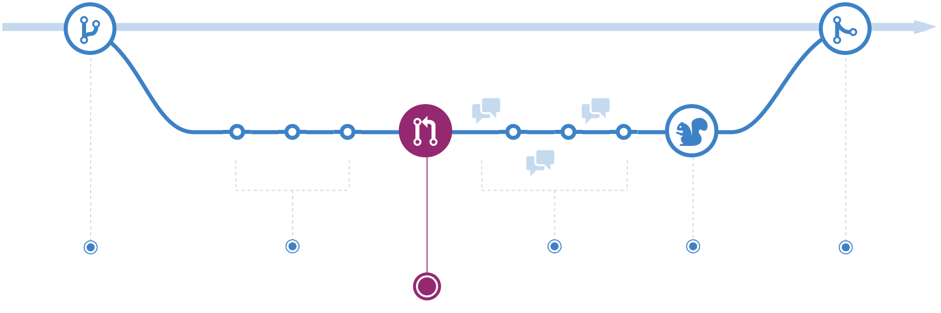
Open a Pull Request
Notes:
PR to get early feedback
In GitHub, you can tag teams, people, etc to increase visibility
Can run CI
Opening PRs early – this can be a cultural change, but by integrating functionality via Actions, the value will be easier to articulate. The use of PRs is only part of the broader need for cultural adoption to fully realize benefits of DevOps

Slide 10
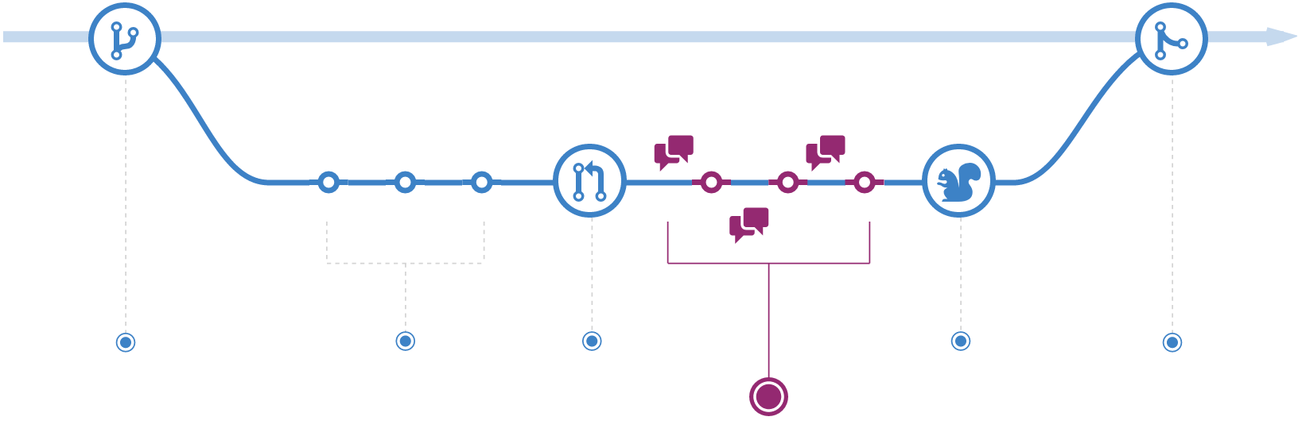
Discuss and Review Code
Notes:
Pull requests are the home of where work happens – this is where CI tests give results, where team members give feedback, etc.

Slide 11
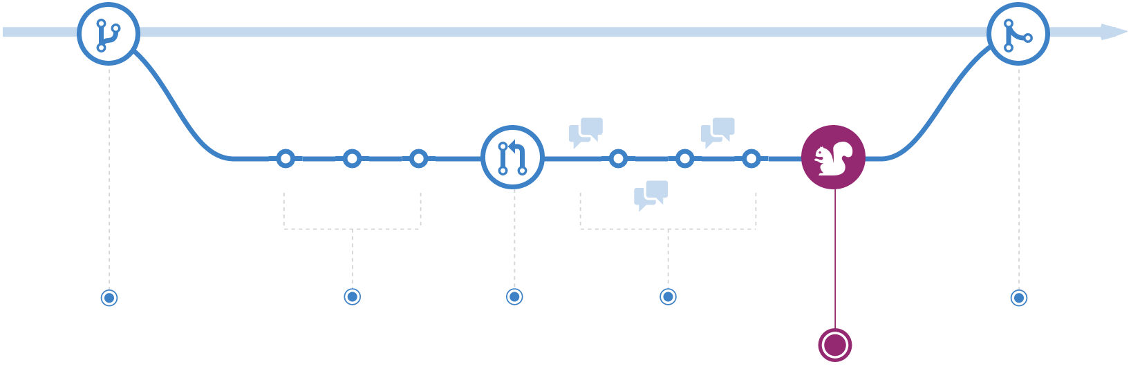
Ship
Notes:
At GitHub we deploy code from a pull request branch, and merge only once it has been confirmed in production. The latest main branch is always merged into the feature branch. It is our stable release branch, so everything on the main branch is considered production-ready code.
If a branch deploy ships bad code containing a bug or performance regression, it is rolled back by deploying the latest main branch to production.
At GitHub we will not ship code that has not been thoroughly reviewed by at least one coworker or is not passing the build tests.

Slide 12
CI

Slide 13


Continuous Integration is a software development practice where members of a team integrate their work frequently, usually each person integrates at least daily - leading to multiple integrations per day.
- Martin Fowler
Notes:
Instead of integration being a long risky process at the end of development or even an iteration, it becomes, with continuous integration, a non-event that happens frequently, multiple times a day.
With the Starter workflows and things like Super linter, https://github.com/github/super-linter/, setting up CI on Actions becomes very trivial.
CI is just one workflow involved in moving a feature or a bugfix from an idea to production, the process also requires packaging the code, setting up environments, having the operations team deploy the software, running functional, and acceptance tests.

Slide 14
Benefits of CI
Ensure code is always in a deployable state
Prioritizes that over working on new features
Fast automated feedback on production readiness
Sustainable
Deployment becomes a business decision
Notes:
Benefits of CI
Code is alway kept in a deployable state
Having strong tests
Using feature flags/toggles or dark ships. GitHub using canary deployments.
A lot of feature toggle frameworks out there
Which means treating the tests, the infrastructure, and release automation as first class citizens
Prioritizing working CI over release of new features
Fast automated feedback on release readiness and releases are happening in a sustainable manner
Examples
New shopping cart for ecommerce app -> rolling deployments to a e.g. specific demographic
A/B testing using feature flags, e.g. send 10% of users to the new feature, 90% to the old one
GitHub customers can get flagged into beta features to get early access, and for GitHub to get early feedback
E.g. team sync
Staff shipping to let employees see code before it’s shipped
It also means that deployment becomes a business decision rather than a technical one (improved confidence)

Slide 15
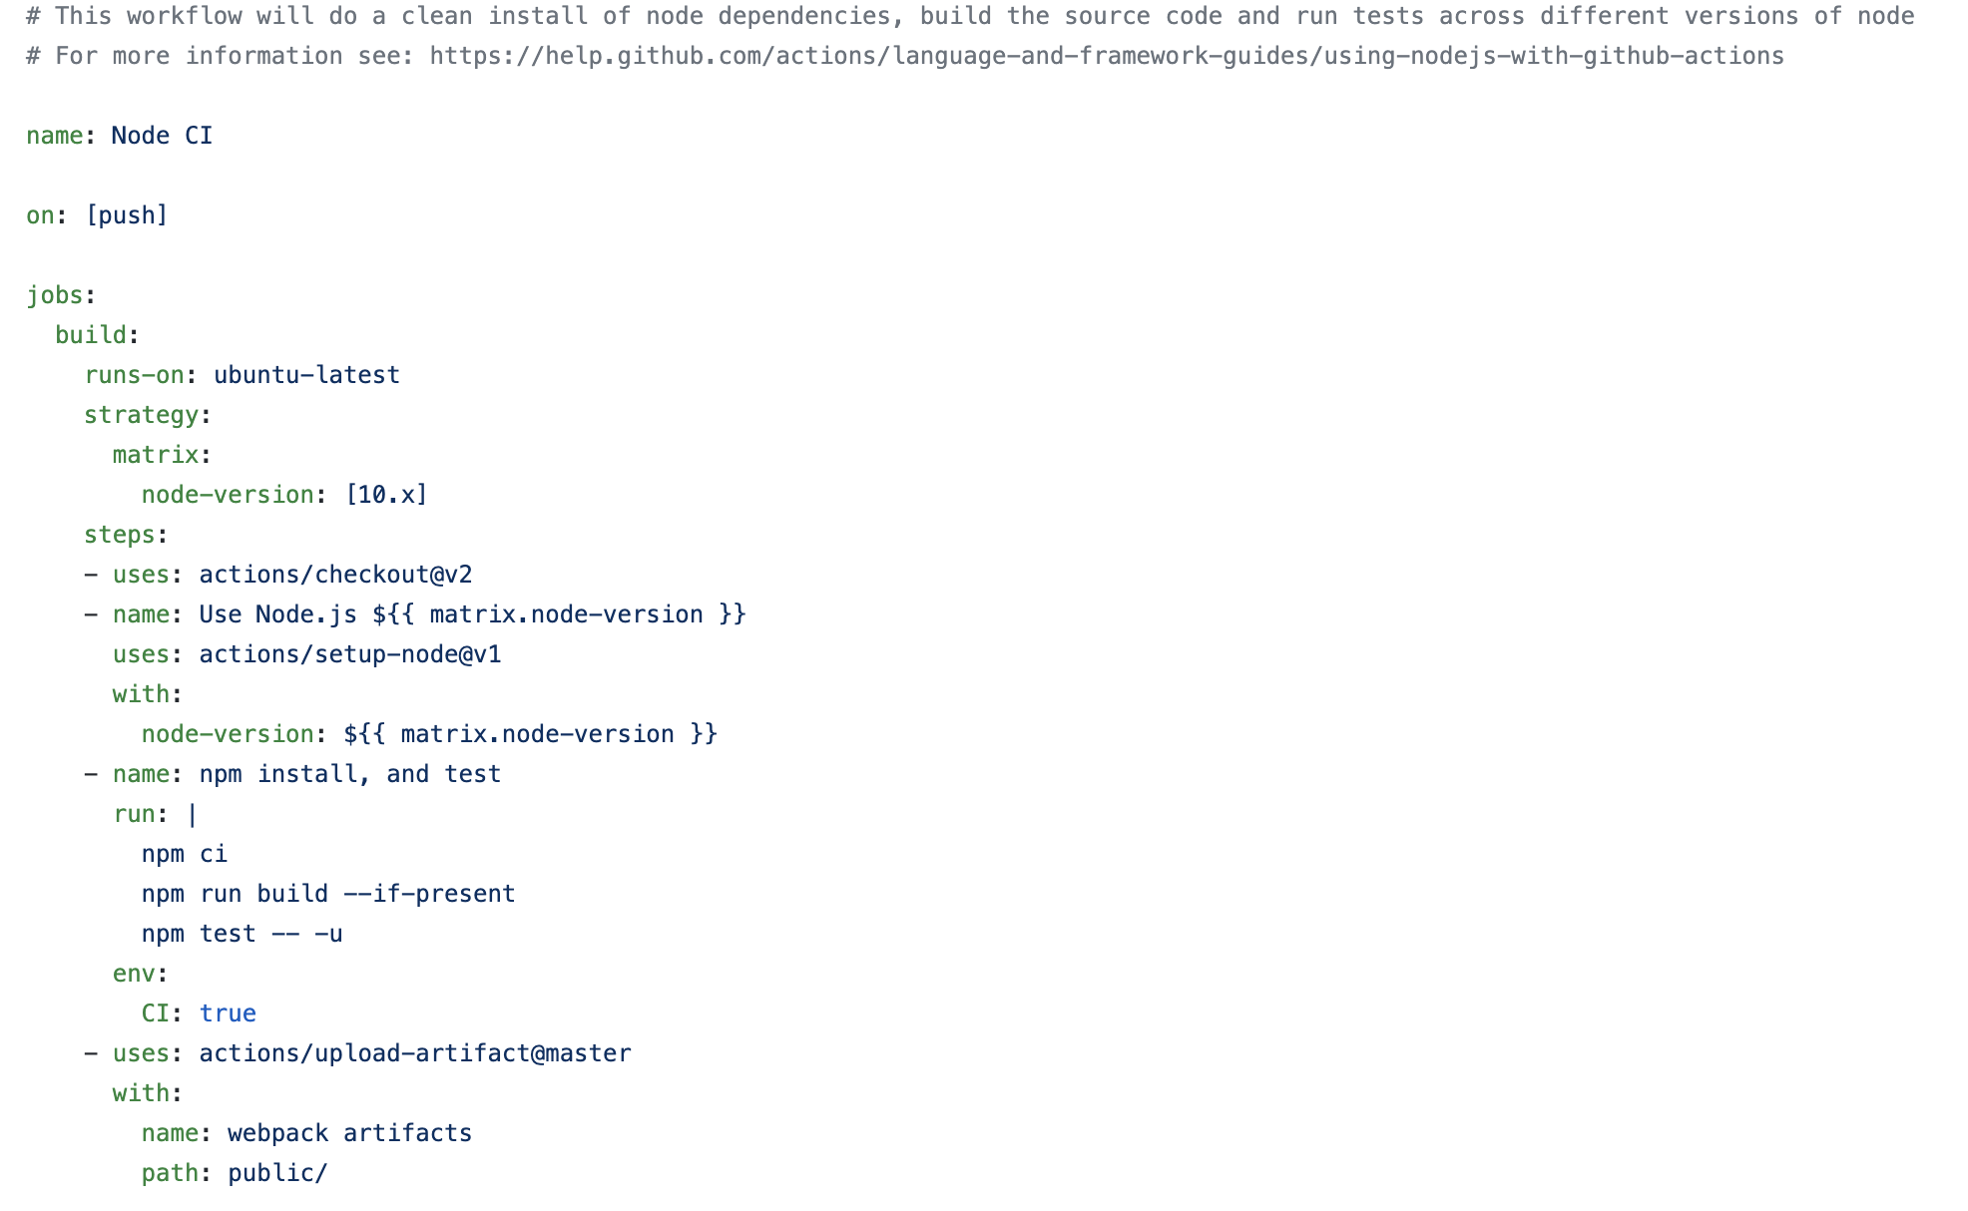
A CI workflow
Single job with 4 steps
Ubuntu
Matrix build
Actions are composable separately
Notes:
A single job, with 4 steps
Runs on the VM
Ubuntu in this case
This is a simple CI workflow one job and 4 steps
The job runs on an ubuntu runner
Node CI
Npm installed by default on the VM runner
It uses matrix build - matrix build are job which takes arrays of inputs (1 or more) and runs the multiple jobs for each combination concurrently
A similar workflow can be created e.g. for maven to test and build your Java apps
********
Resources
Learning Lab: https://lab.github.com/githubtraining/github-actions:-continuous-integration
Setup for most languages in github.com/actions
********

Slide 16
A CI workflow
Checkout is separate
Setup for most languages in github.com/actions
npm run by shell
Artifact uploaded separately
Notes:
Walk through the steps in appropriate detail for the audience
Note the last step; making use of the GitHub-provided artifact storage

Slide 17
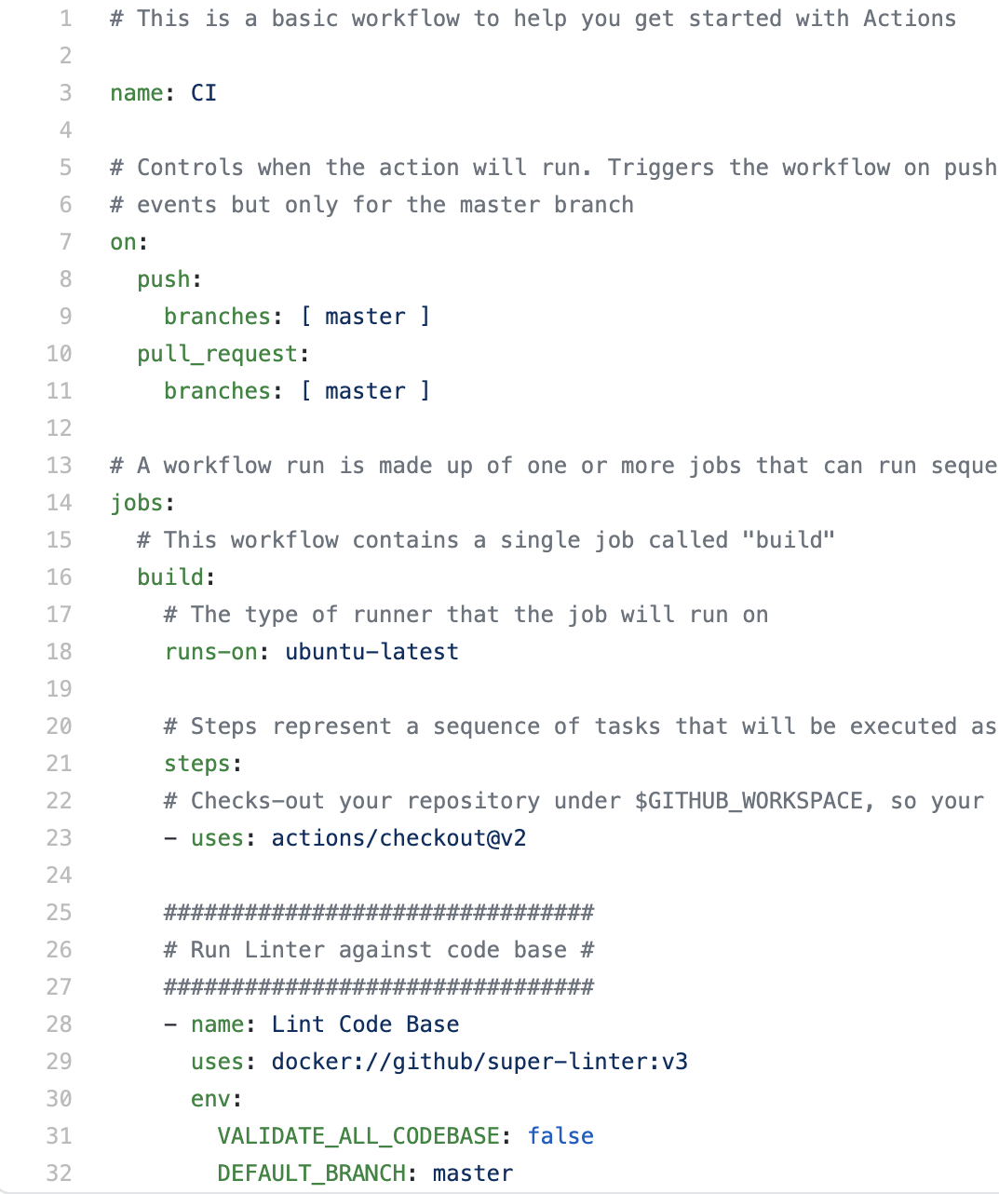
Super linter
Ready to use for most languages
checkout
super-linter
https://github.com/github/super-linter/
Notes:
The super linter validates your code by checking it for programmatic and styling errors.
It is also very easy to add code quality checks here
One such example is super linter which checks for a wide range of languages and frameworks (js, md, ...)
Here is a very simple example - checkout the code on push or pull requests and Lint the codebase.
********
Resources
https://github.com/github/super-linter/
********

Slide 18
CD & release management

Slide 19
Continuous Delivery is a software development discipline where you build software in such a way that the software can be released to production at any time.
- Martin Fowler
Notes:
At this point we have covered some aspects of CI
Usually at this time a package is created and stored a package artifact repo
We will cover that in the later slides during Package Management
********************
Note to presenter:
Please be sure to highlight the difference between Continuous Delivery and Continuous Deploy. With continuous delivery, changes are added to the main branch after tests have passed. Continuous deployment goes and extra step by releasing to the customer in addition to adding changes to the main branch of code.
********************

Slide 20
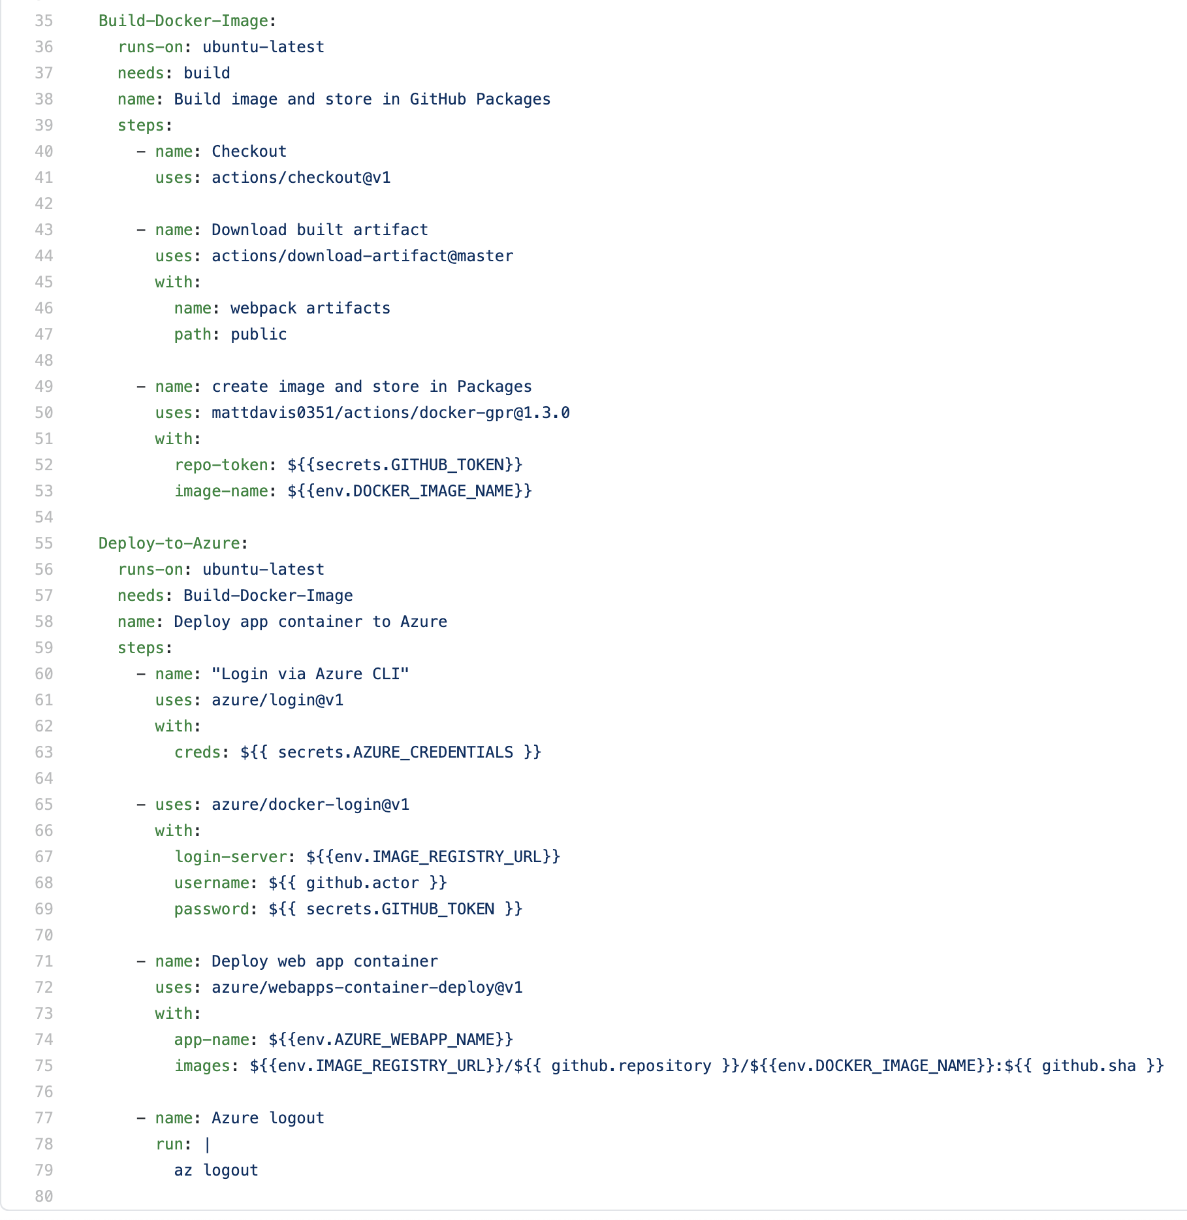
A CD workflow
Store the image in GitHub
Jobs run on different envs
Uses the Docker image
Deploys the container image to Azure
Notes:
Builds an image and stores it in GitHub Package Registry
GitHub Container Registry now in beta, can also be stored there
Deploys the image
Depends on build job
Authenticates with Azure using the CLI
Deploys to Azure WebApp container
With an app name and image URI
Deploys to AWS ECS (Elastic Container Service)
********
Resources
https://lab.github.com/githubtraining/github-actions:-continuous-delivery-with-azure
********

Slide 21
Deploy to Azure App Service
Store the image in GitHub
Jobs run on different envs
Uses the Docker image
Stores Docker Image in GitHub
Deploys the container image to Azure
Notes:
Builds an image and stores it in GitHub Package Registry
GitHub Container Registry now in beta, can also be stored there
Deploys the image
Depends on build job
Authenticates with Azure using the CLI
Deploys to Azure WebApp container
With an app name and image URI
Deploys to AWS ECS (Elastic Container Service)
********
Resources
https://lab.github.com/githubtraining/github-actions:-continuous-delivery-with-azure
********

Slide 22
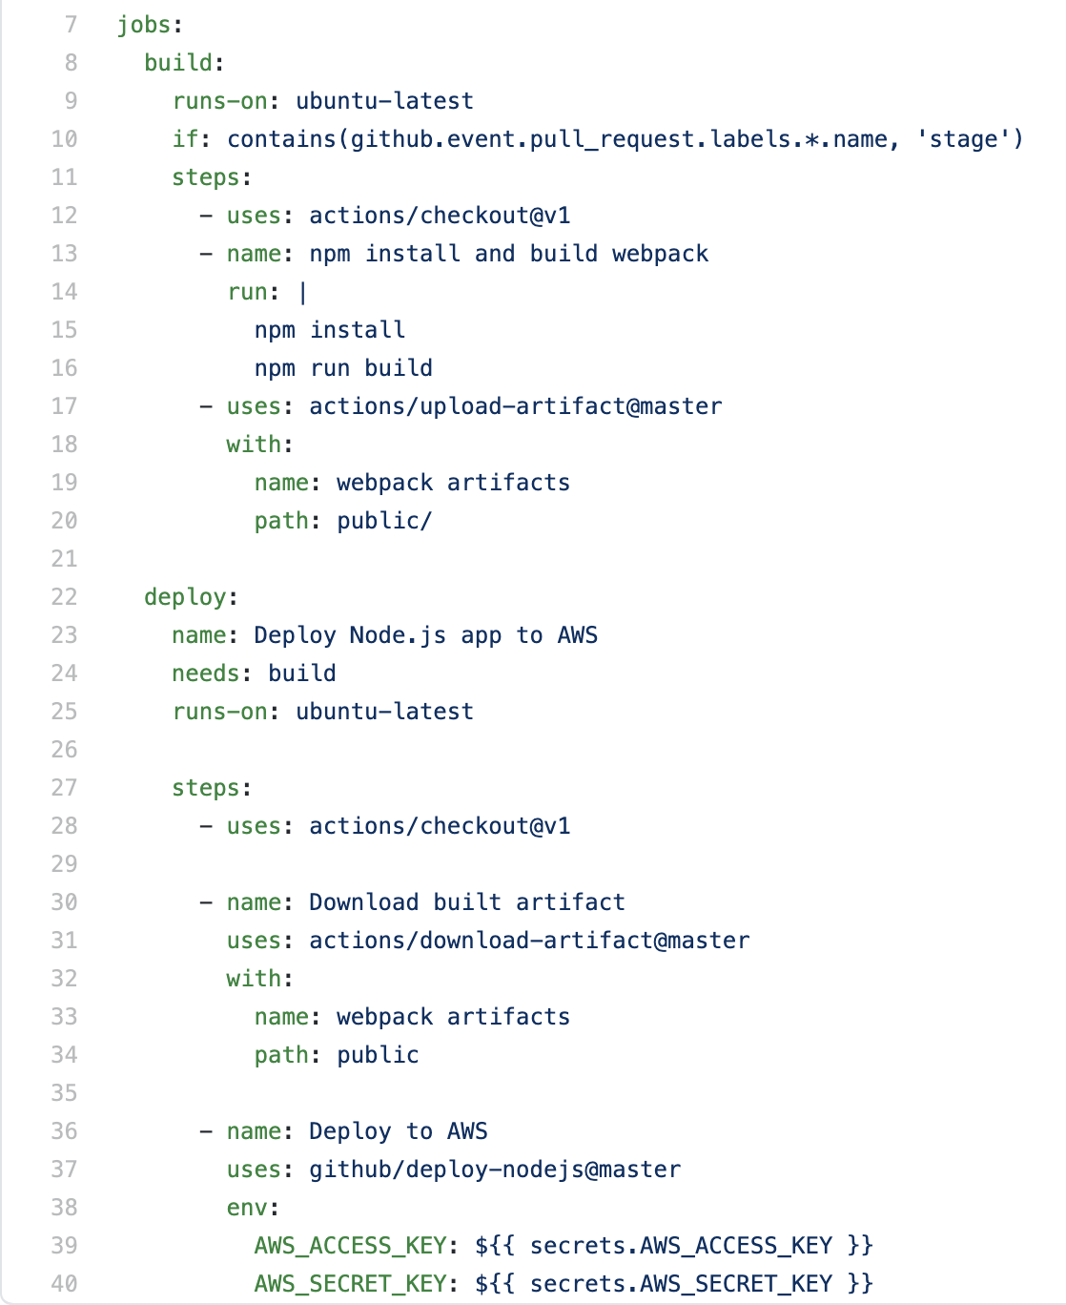
Deploy to AWS Serverless
Two jobs; build and deploy
Build: npm artifact
Deploy: download artifact and deploy to AWS
Notes:
Two jobs; build and deploy
Dependency defined deploy -> build
Two jobs; build and deployDeploys a NodeJS App using AWS Lambda
Requires AWS IAM User, S3 buckets
Uses SAM template
********
Resources
https://lab.github.com/githubtraining/github-actions:-continuous-delivery-with-aws
********

Slide 23
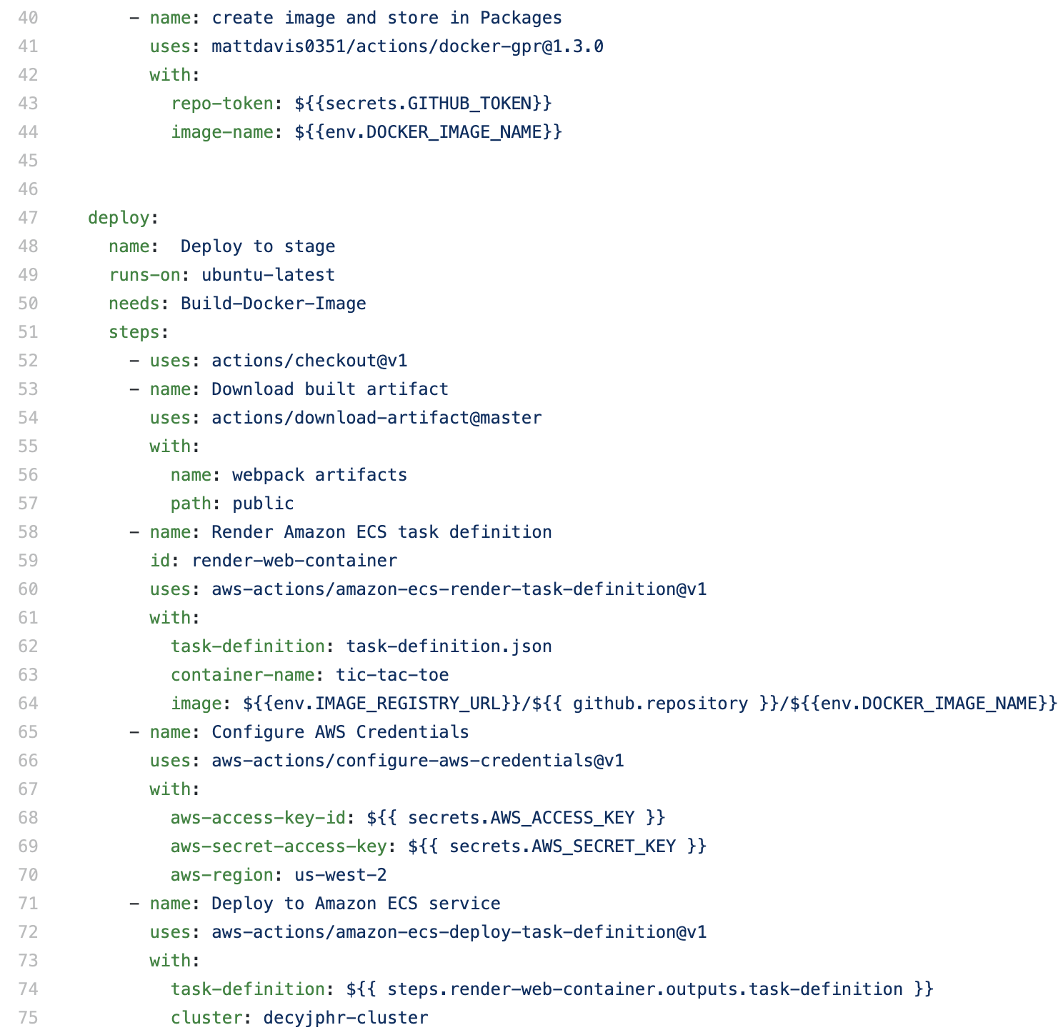
Deploy to ECS
Store the image in GitHub
Dynamically build a task definition
Configure AWS credentials
Deploy using a task definition
Uses private registry authentication
Requires proper ECS task execution IAM role
Notes:
Builds an image and stores it in GitHub Package Registry
GitHub Container Registry now in beta, can also be stored there
Deploys the image
Depends on build job
ECS render task definition job
Creates a new ECS task definition file using the image URI
Configure AWS credentials
Determines which credentials and region to use for AWS API calls
Deploys to AWS ECS (Elastic Container Service)

Slide 24
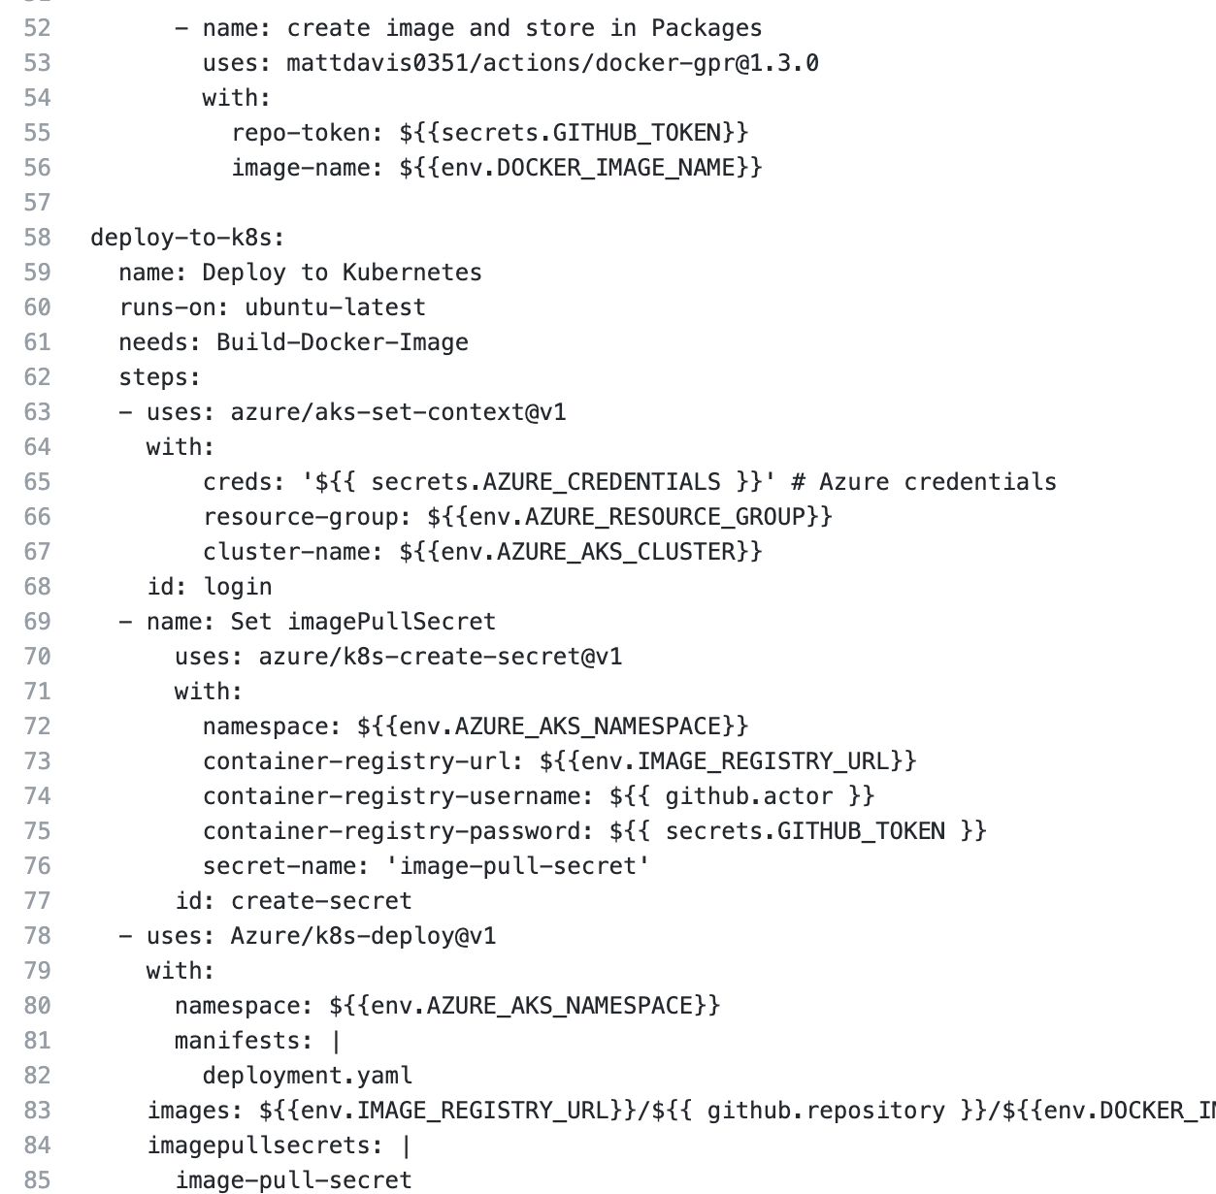
Deploy to Kubernetes
Store the image in GitHub
Log into the AKS cluster
Create an image pull secret
Deploy App using a deployment manifest

Slide 25
GitHub Actions Environments

Slide 26
Environments
Logical representation of your environments
Dev – Test – QA – PreProd – Prod…
Whole environment or “slice”
Can define their own secrets
Have protection rules

Slide 27
Protection rules
Required reviewers
Wait timer
Allowed branches
APIs for 3rd party integration

Slide 28
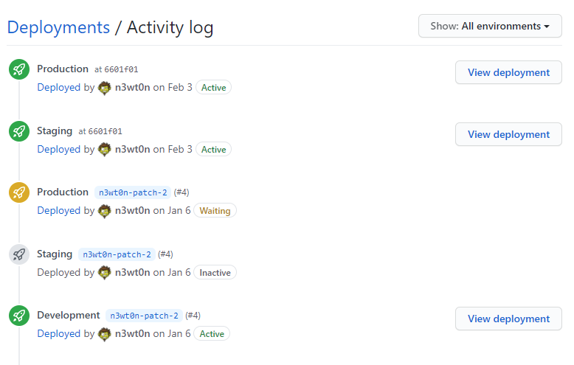
Deployment logs
Single or Multiple environments
Complete history of deployment
Status of deployment
Notes:
Things to keep in mind:
Events kick off the workflow
Jobs run each in their own VM
In parallel (unless the workflow says otherwise)
Job specifies the VM Linux/Windows/MacOS
Steps run in the same VM
Share filesystem
Logs are searchable, link to individual lines
Artifacts can be saved
Can run jobs in parallel or in sequence `using` the needs option
Within jobs you have individual steps that run in sequence
Note: You can chain workflows using the workflow_run event

Slide 29

DEMO

Slide 30
Questions
Notes:
********************
Note to presenter:
The questions below are for your reference only. They are ones that you can anticipate receiving from the audience. However, there is no need to pose these to your audience.
********************
Q: I can trigger a workflow on release creation but there doesn't appear to be an action to download release artifacts. Does one exist? If not, do you know if there are plans to create one? I know I could curl/Invoke-WebRequest them but it would be nice to not have to get that low level.
A: https://docs.github.com/en/actions/reference/workflow-syntax-for-github-actions#jobsjobs_idoutputs
Q: Okay about pull request triggers in GitHub actions. Is it similar to Azure pipelines, where it checks out that topic branch into a temporary branch and then it merges with the master and then you execute the work on the merged code? Is it similar?
A: You get a SHA that's going to be the merge itself and then you get the base branch (master/main). So yes, you get a SHA for the merged commit.
Q: And the question is on the GitHub. So on GitHub - do you merge and then deploy. So do you merge the topic branch with Master and then deploy. Or, would you deploy the topic branch and then merge with master?
A: So what we recommend to enterprises is as best as they can, they should try to stick to this GitHub flow, which does actually have you do a deployment before you merge into your default branch. And that's usually a question that a lot of people come up with when we have what we call our workflow consultations. And that question that comes up is, like, well, wait a second, why do you want me to deploy code that hasn't been tested yet? Like, it's not even in Main, why am I doing that? And the reason for that is we want our main or default branch here to be a record of working code. You know, to the best of our knowledge working code. So we can deploy out this feature tested in production behind, let's say, a feature flag or some type of dark shipping type system. And then when we know it's working. We can merge that back into our main default branch and if it did fail and cause some type of issue we know we can redeploy the latest commit on our default branch. And that's going to be good working code. So it allows us an easy way to roll back while also being able to test out our feature right before we actually merge it in with our history or timeline of good working code.
Q: So when you say you deploy from the topic branch. You really mean that merge commits, right, that includes latest changes in the master, right, because otherwise, someone else might have changed the master/main branch
A: Yeah. Yeah, exactly. There are ways to do this with including checks that main has been merged into the topic branch, or including branches on train deploys.

